Slide 1

City of Boston
311 Service Request
Data Analysis
by the BU MSSP 2015-16 Cohort

Slide 2
Big Picture

Slide 3

Context
MS in Statistical Practice (MSSP) Program: A new BU masters program, with focus on producing holistically trained statisticians to work in an integrated fashion in the modern data-science environment.
At the heart of the program is the Statistics Practicum -- where “it all comes together”.
The Bos 311 data were used this semester in the Practicum as the data set upon which to focus skills development, practice of principles, and team building.
End product was a comprehensive analysis and corresponding analytics platform, focused on the topic of Quality of Service.

Slide 4
Overview of Presentation
Preliminaries: Data Cleaning and Manipulation
Exploratory Data Analysis of QoS Metrics
Revisiting Efficiency
The Role of Target Times
Impact of Demographics
Concluding Remarks

Slide 5
Data Cleaning and Manipulation

Slide 6
Data Cleaning
The 311 Service Request dataset from the City of Boston was downloaded and imported into R. The following steps were then taken:
Filters / exclusions / removals:
Filter data to select only requests from 2014.
Exclude requests
generated by city employees (Source field: City Worker App and Employee Generated); or
where open date is later than the closed date
Remove
incomplete records;
requests with Closure Reasons containing “invalid” or “duplicate”;
requests that were closed within 15 minutes of opening.

Slide 7
Data Manipulation
2. Four key quality-related metrics were defined:
Request Volume [count] = total number of requests
Duration [hours] = (Closed Time) - (Open Time)
On-Time Rate [ratio] = (Number of On -Time Requests) / (Total Number of Requests)
Efficiency [ratio] = (Target Time - Open Time) / (Closed Time - Open Time)
Note: Metric summaries typically used the median because of its resistance to outliers & heavy tails.
3. Aggregation: Data were, for some analyses, regrouped by department and neighborhood.

Slide 8
Additional Data Sources: Demographics
Data from the 2010 Census (Census Tract Level):
Total Population
Total White Population, Total Black Population, Total Asian Population, Total Hispanic Population, Total Male Population, Total Female Population, Total Population over 18
All of these were turned into percentages of the total population
Area (Square Miles)
Dividing total population by area led to population density
Median Age
Data from 2013 American Community Survey (Also Census Tract Level)
Median Income

Slide 9
Exploratory Data Analysis

Slide 10
Exploration Using Shiny
We conducted a variety of exploratory data analyses of the Bos311 data.
In order to facilitate exploration, communication and sharing of our results, we incorporated final versions of select analyses into an interactive Shiny Application in R.
Focus on 3 Visualizations
Scatter Plots
Bubble Charts
Maps
Link to Shiny Application

Slide 11
Revisiting Efficiency

Slide 12
Closer Look at Efficiency
Efficiency was defined objectively using open time, target time, and closed time, but how you define efficiency matters!
To investigate efficiency further, we looked at 2 things:
Impact of Target Time
( Closed Time - Open Time ) / r *( Target Time - Open Time)
Finding: Differential impact of varying relative target times
Impact of Demographics
Regression analysis allows for notion of efficiency, adjusted for demographics.
Finding: Modest effects.
Link back to Shiny Application

Slide 13
Adjusting for Demographics?
It might be argued that departments have their efficiency affected differentially due to interaction of
their particular services (e.g., parks versus schools), and
demographics (e.g., neighborhood age, income, density)
To assess this possibility, we used regression analysis to adjust for demographics, comparing
and
QoS Metric ~ Department
QoS Metric ~ Department + Demographics

Slide 14
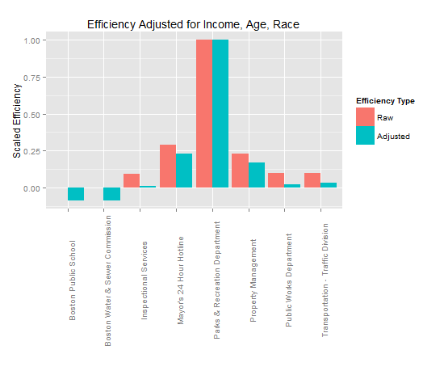
Efficiency and Demographics

Slide 15
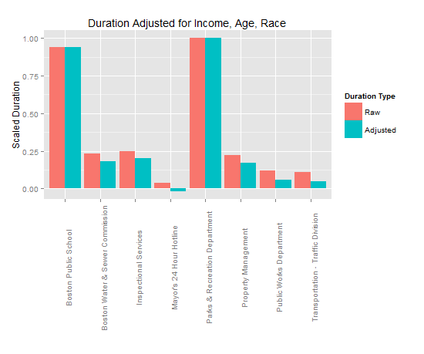
Duration and Demographics

Slide 16
Take-Home Points

Slide 17
Takeaways To Think About
Visualizations and interactive Shiny environment allow for rich and simultaneous analysis of multiple, interacting quality metrics and variables.
Definition of high-level concepts from low-level data needs care.
E.g., “Efficiency” may reflect differences in budget/manpower, difficulty of requests, over-estimation of target time, etc.
Confounding of efficiency with demographics appears to be modest.
Data on “Effectiveness” of work done would be a useful complement

Slide 18
Contributors
Students
Qian Fang, Frank Giron, Brian Hart, Jing Liu, Zhuojin Lyu, Jeffrey Paadre, Hankui Peng, Rhea Roy, Jiayuan Shi, Yulan Sun, Su Yang, Jiapeng Yuan, Hanxi Zhang, Xiaoyi Zhang, Lina Zhou, Yitong Zhou, Jingshu Wu
Teaching Fellows
Aleksandrina Goeva and Clementine Mottet
Professors
Dr. Eric Kolaczyk and Dr. Haviland Wright
Program Coordinator
Marisa DiSarno

